Slide 1
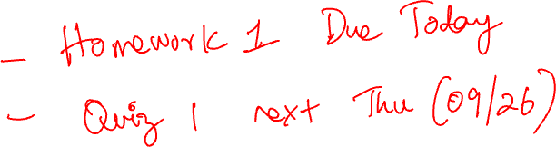
Exploratory Data Analysis
CS 418 Introduction to Data Science
Prof. Sathya Ravi
September 19, 2024

Slide 2
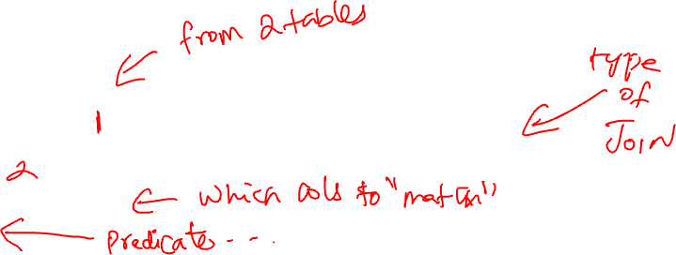
JOIN VARIANTS
SELECT (column_list)
FROM table_name
[INNER | LEFT OUTER |RIGHT OUTER | FULL OUTER] JOIN table_name
ON qualification_list
WHERE …
INNER is default
Inner join is akin to what we have seen so far.
FULL OUTER is the equivalent of join=‘outer’ in pandas.
“OUTER” is optional, but recommended for clarity.

Slide 3
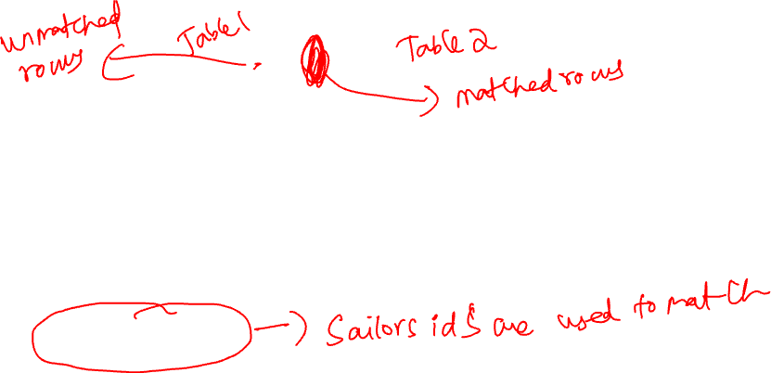
LEFT JOIN
Returns all matched rows, and preserves all unmatched rows from the table on the left of the join clause
(use nulls in fields of non-matching tuples)
SELECT s.sid, s.sname, r.bid
FROM Sailors2 s LEFT OUTER JOIN Reserves2 r
ON s.sid = r.sid;
Returns all sailors & bid for boat in any of their reservations
Note: If there is a sailor without a boat reservation then the sailor is matched with the NULL bid.

Slide 4
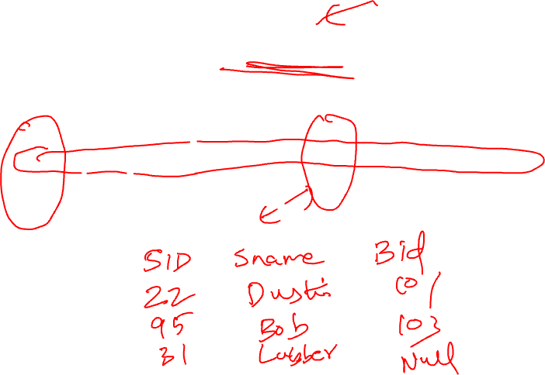
SELECT S.SID, S.SNAME, R.BID FROM SAILORS2 S LEFT OUTER JOIN RESERVES2 R ON S.SID = R.SID;
Sailors2
Reserves2
sid | sname | rating | age
22 | Dustin | 7 | 45
31 | Lubber | 8 | 55.5
95 | Bob | 3 | 63.5
sid | bid | day
22 | 101 | 1996-10-10
95 | 103 | 1996-11-12
sid | sname | bid
22 | Dustin | 101
95 | Bob | 103
31 | Lubber | (null)
http://sqlfiddle.com/#!17/54a88/2

Slide 5

LEFT JOIN VS. LEFT OUTER JOIN
SELECT s.sid, s.sname, r.bid
FROM Sailors2 s LEFT OUTER JOIN Reserves2 r
ON s.sid = r.sid;
is the exact same as:
SELECT s.sid, s.sname, r.bid
FROM Sailors2 s LEFT JOIN Reserves2 r
ON s.sid = r.sid;
Also called a Left Outer Join (note that there is no such thing as a Left Inner Join)

Slide 6
RIGHT JOIN
Right join returns all matched rows, and preserves all unmatched rows from the table on the right of the join clause
SELECT r.sid, b.bid, b.bname
FROM Reserves2 r RIGHT OUTER JOIN Boats2 b
ON r.bid = b.bid;
Returns all boats & information on which ones are reserved.
No match for b.bid? r.sid IS NULL!
As before, there is no such thing as a right inner join!

Slide 7
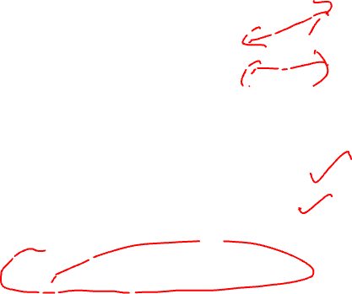
SELECT R.SID, B.BID, B.BNAME FROM RESERVES2 R RIGHT OUTER JOIN BOATS2 B ON R.BID = B.BID;
Boats2
Reserves2
bid | bname | color
101 | Interlake | blue
102 | Interlake | red
103 | Clipper | green
104 | Marine | red
sid | bid | day
22 | 101 | 1996-10-10
95 | 103 | 1996-11-12
sid | bid | bname
22 | 101 | Interlake
95 | 103 | Clipper
(null) | 104 | Marine
(null) | 102 | Interlake
Result:
http://sqlfiddle.com/#!17/a7b2f/1

Slide 8

FULL OUTER JOIN
Full Outer Join returns all (matched or unmatched) rows from the tables on both sides of the join clause
SELECT r.sid, b.bid, b.bname
FROM Reserves2 r FULL OUTER JOIN Boats2 b
ON r.bid = b.bid
If no boat for a sailor? 🡪 b.bid IS NULL AND b.bname IS NULL!
If no sailor for a boat? 🡪 r.sid IS NULL!
Is this the same as Cartesian Product?

Slide 9
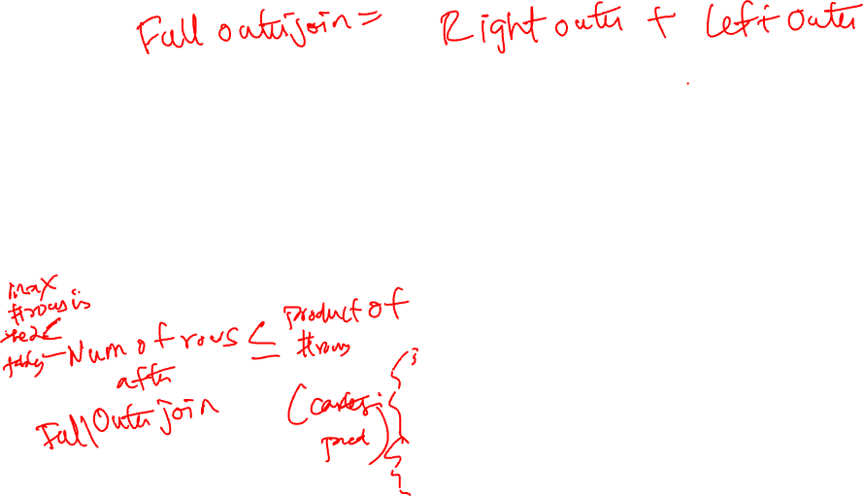
SELECT R.SID, B.BID, B.BNAME FROM RESERVES3 R FULL JOIN BOATS2 B ON R.BID = B.BID
Boats2
Reserves3
bid | bname | color
101 | Interlake | blue
102 | Interlake | red
103 | Clipper | green
104 | Marine | red
sid | bid | day
22 | 101 | 1996-10-10
95 | 103 | 1996-11-12
38 | 42 | 2010-08-21
Result:
sid | bid | bname
22 | 101 | Interlake
95 | 103 | Clipper
38 | (null) | (null)
(null) | 104 | Marine
(null) | 102 | Interlake
http://sqlfiddle.com/#!17/e1f3a/3/0

Slide 10
NULL VALUES
Field values are sometimes unknown
SQL provides a special value NULL for such situations.
Every data type can be NULL
The presence of null complicates many issues. E.g.:
Selection predicates (WHERE)
Aggregation
But NULLs are common after outer joins

Slide 11
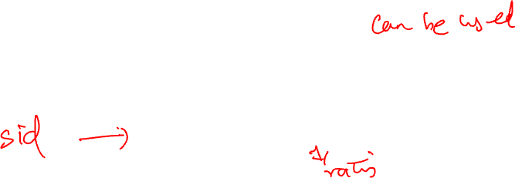
NULL IN THE WHERE CLAUSE
Consider a tuple where rating IS NULL.
If we run the following query
Jack Sparrow will not be included in the output.
INSERT INTO sailors VALUES (11, 'Jack Sparrow', NULL, 35);
SELECT * FROM sailors
WHERE rating > 8;
http://sqlfiddle.com/#!17/36ca9/2

Slide 12


NULL IN COMPARATORS
What entries are in the output of all these queries?
SELECT rating = NULL FROM sailors;
SELECT rating < NULL FROM sailors;
SELECT rating >= NULL FROM sailors;
SELECT * FROM sailors WHERE rating = NULL;
Rule: (x op NULL) evaluates to … NULL!
All of these queries evaluate to null!
Even this one!
http://sqlfiddle.com/#!17/f35aa/6

Slide 13
EXPLICIT NULL CHECKS
To check if a value is NULL you must use explicit NULL checks
SELECT * FROM sailors WHERE rating IS NULL;
SELECT * FROM sailors WHERE rating IS NOT NULL;
http://sqlfiddle.com/#!17/f35aa/4

Slide 14
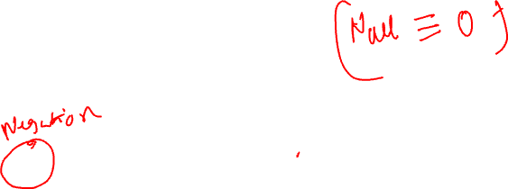
NULL IN BOOLEAN LOGIC
And
Or
 | T | F | N
T | T | F | N
F | F | F | F
N | N | F | N
 | T | F | N
T | T | T | T
F | T | F | N
N | T | N | N
Three-valued logic:
SELECT * FROM sailors WHERE rating > 8 AND TRUE;
SELECT * FROM sailors WHERE rating > 8 OR TRUE;
SELECT * FROM sailors WHERE NOT (rating > 8);
Not
T | F | N
F | T | N
http://sqlfiddle.com/#!17/f35aa/2

Slide 15
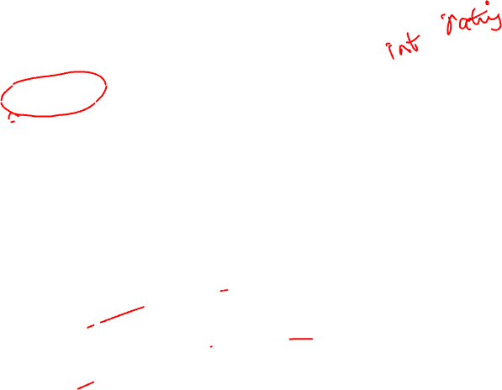
NULL AND AGGREGATION
SELECT count(rating) FROM sailors;
4
SELECT sum(rating) FROM sailors;
27
SELECT avg(rating) FROM sailors;
??
SELECT count(*) FROM sailors;
??
sid | sname | rating | age
1 | Popeye | 10 | 22
2 | OliveOyl | 11 | 39
3 | Garfield | 1 | 27
4 | Bob | 5 | 19
11 | Jack Sparrow | (null) | 35
http://sqlfiddle.com/#!17/f35aa/7

Slide 16

NULL AND AGGREGATION
SELECT count(rating) FROM sailors;
4
SELECT sum(rating) FROM sailors;
27
SELECT avg(rating) FROM sailors;
(10+11+1+5) / 4 = 6.75
SELECT count(*) FROM sailors;
5
sid | sname | rating | age
1 | Popeye | 10 | 22
2 | OliveOyl | 11 | 39
3 | Garfield | 1 | 27
4 | Bob | 5 | 19
11 | Jack Sparrow | (null) | 35
http://sqlfiddle.com/#!17/f35aa/7

Slide 17
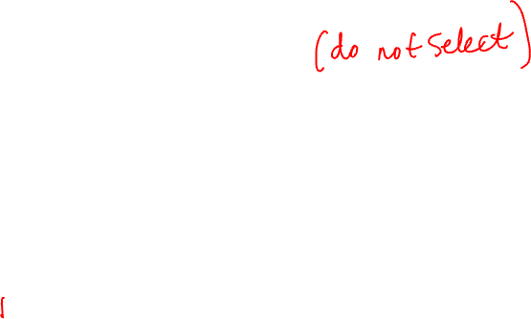
NULLS: SUMMARY
NULL op NULL is NULL
WHERE NULL: do not send to output
Boolean connectives: 3-valued logic
Aggregates ignore NULL-valued inputs

Slide 18
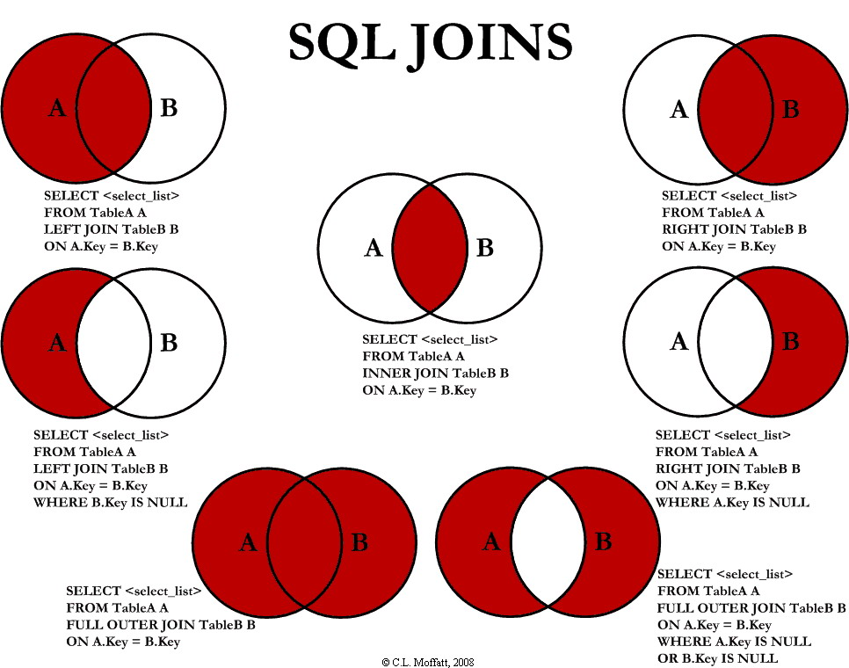
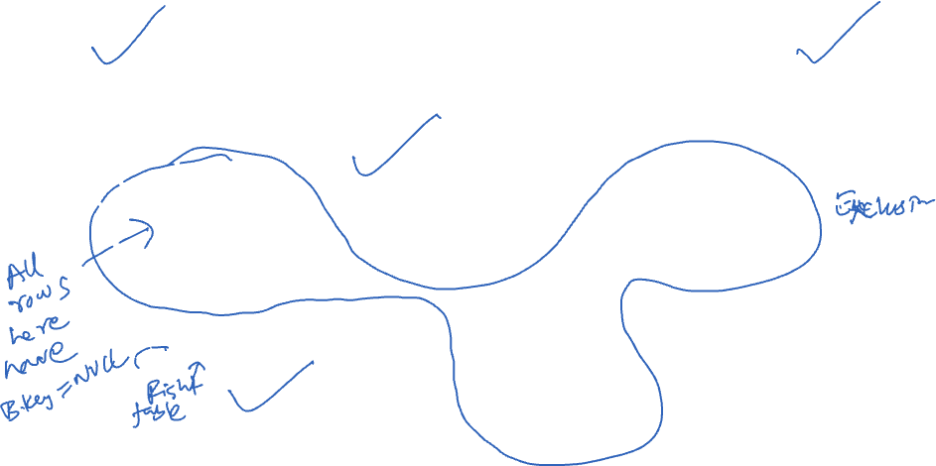

Slide 19
HOW DO YOU INTERACT WITH A DATABASE?
What is the DBMS?
Server
Software
A library
Answer: It can be all of these.

Slide 20

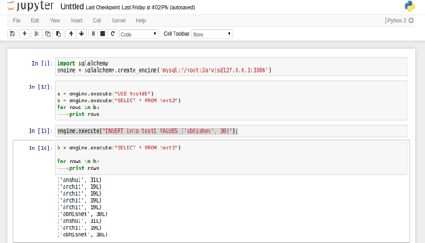

INTERACTING WITH A DBMS
Query
SELECT * FROM sales
WHERE price > 100.0
DBMS Server on
your own machine
Python Analysis
Response
Date | Purchase ID | Name | Price
9/20/2012 | 1234 | Sue | $200.00
8/21/2012 | 3453 | Joe | $333.99

Slide 21



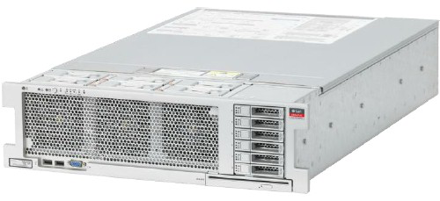
INTERACTING WITH A DBMS
Cust.
Prod.
Sales
Query
SELECT * FROM sales
WHERE price > 100.0
DBMS Server
Python Analysis
Response
Date | Purchase ID | Name | Price
9/20/2012 | 1234 | Sue | $200.00
8/21/2012 | 3453 | Joe | $333.99

Slide 22





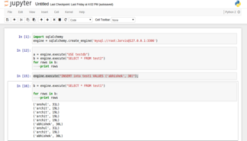
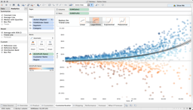

INTERACTING WITH A DBMS
Cust.
Prod.
Sales
Web Servers
DBMS Server
HTTP
Web Applications
Often many systems will connect to a DBMS concurrently.
Python Analysis
Visualization

Slide 23



WHY ARE DATABASES DRAWN AS “CANS”

Slide 24

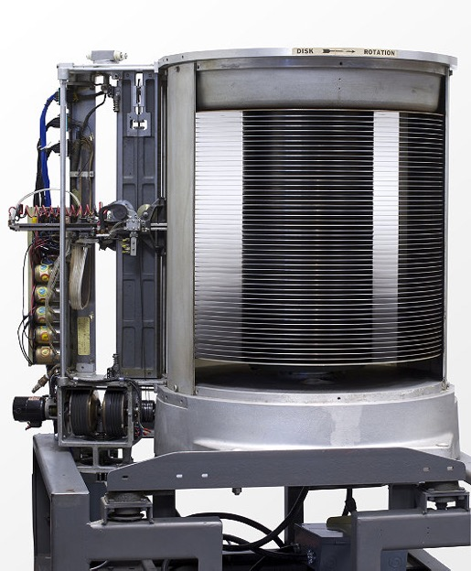

Platters on a Disk Drive
Looks Like?
1956: IBM MODEL 350 RAMAC
First Commercial Disk Drive
5MB @ 1 ton

Slide 25


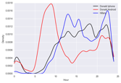

Question & Problem Formulation
?
Now
Data Acquisition
& Wrangling
Exploratory Data Analysis (EDA)
Descriptive statistics
Prediction and Inference
Exploratory Data Analysis

Slide 26
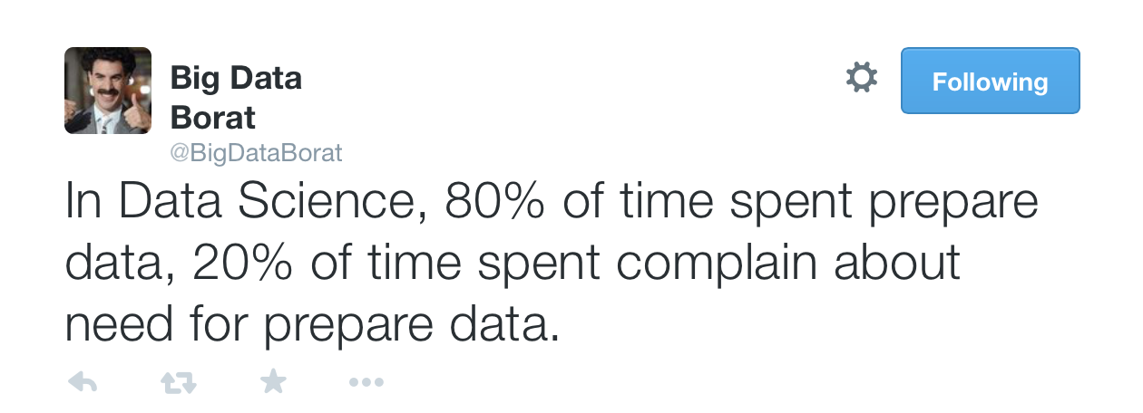
DATA WRANGLING
The process of transforming raw data to facilitate meaningful subsequent analysis
Data wrangling often addresses
structure / formatting
missing or corrupted values
unit conversion
encoding text as numbers
…
Sadly data wrangling is a big part of data science…

Slide 27

EXPLORATORY DATA ANALYSIS (EDA)
“Getting to know the data”
The process of transforming, visualizing, and summarizing data to:
Build/confirm understanding of the data and its provenance
Identify and address potential issues in the data
Inform the subsequent analysis
Discover potential hypothesis … (be careful)
EDA is an open-ended analysis (vs. starting with a hypothesis)
Be willing to find something surprising

Slide 28

John Tukey
Princeton Mathematician & Statistician
Introduced
Fast Fourier Transform
“Bit” : binary digit
Exploratory Data Analysis
Early Data Scientist
Data Analysis & Statistics, Tukey 1965
Image from LIFE Magazine
Notes:
John Tukey, Princeton mathematician and statistician, inventor of the Fast Fourier Transform and father of Exploratory Data Analysis. Also coined the word “bit”.
Emphasis courtesy Jeff Heer, U. Washington

Slide 29
EDA is like detective work
“Exploratory data analysis is an attitude, a state of flexibility, a willingness to look for those things that we believe are not there, as well as those that we believe to be there.”
Data Analysis & Statistics, Tukey 1965
Image from LIFE Magazine

Slide 30

INSIGHT
Good Data Analysis is not:
Simple Application of a Statistics Recipe.
Simple Application of Statistical Software.
There are many tools out there for data science, but they are merely tools.
They don’t do any of the important thinking!
“The purpose of computing is insight, not numbers.” - R. Hamming. Numerical Methods for Scientists and Engineers (1962).

Slide 31

DESCRIPTIVE STATISTICS

Slide 32

DESCRIPTIVE VS. INFERENTIAL STATISTICS
Statistics deals with the collection, analysis, interpretation, and presentation of data
There are two types of statistical analysis: descriptive statistics and inferential statistics
Descriptive statistics focuses on summarizing data about a sample drawn from a population
Measures of central tendency (mean, median, mode)
Measures of dispersion or spread (range, standard deviation, variance)
Inferential statistics focuses on using information from the sample to make conclusions

Slide 33
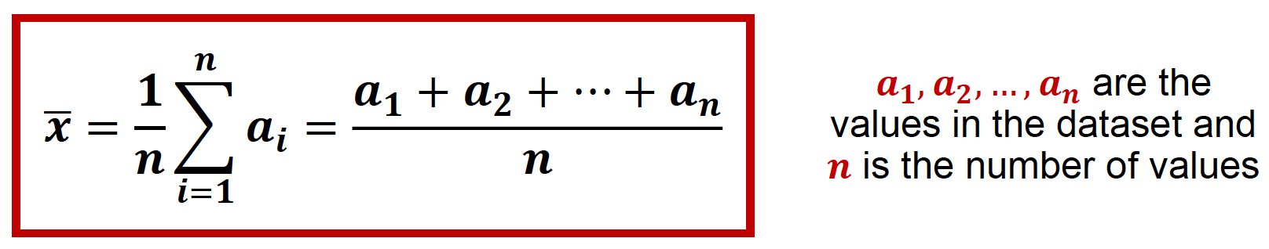
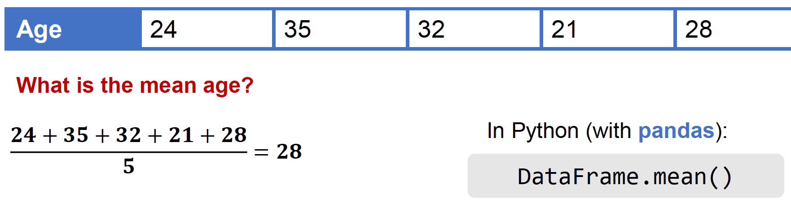
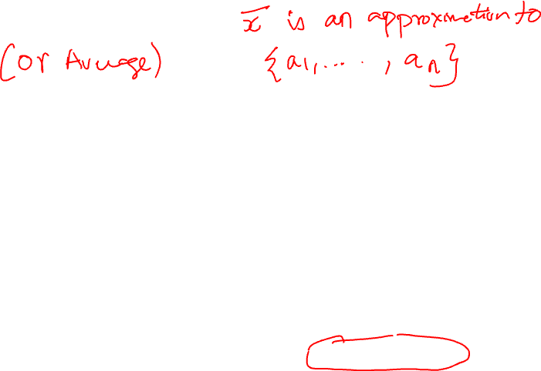
MEASURES OF CENTER: MEAN
The arithmetic mean (or average) of a dataset is the sum of the values in the dataset divided by the number of values
Example

Slide 34
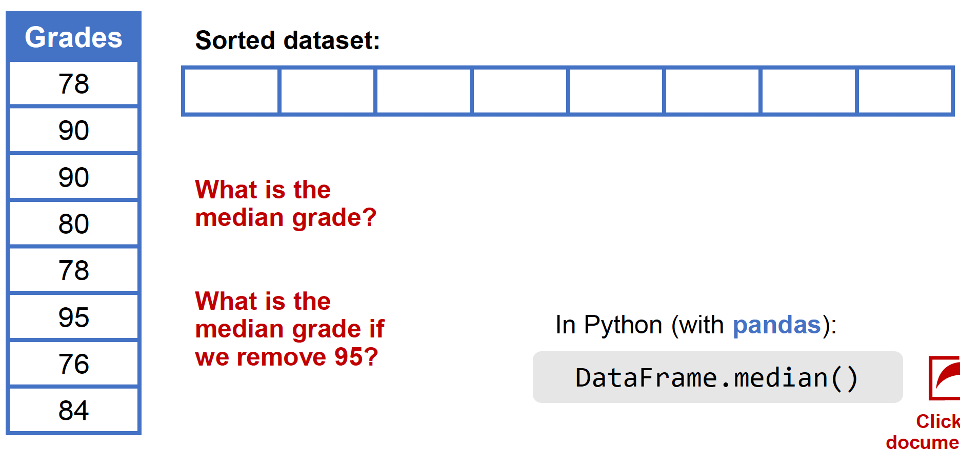
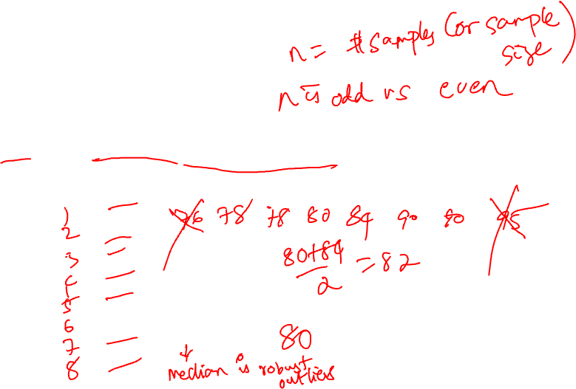
MEASURES OF CENTER: MEDIAN
The median of a dataset is the middle value (if the number of values is odd) or the mean of the two middle values (if the number of values is even) in the sorted dataset
Example

Slide 35
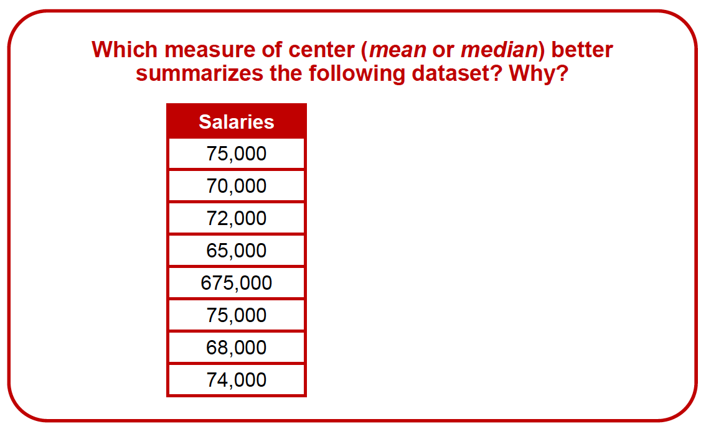
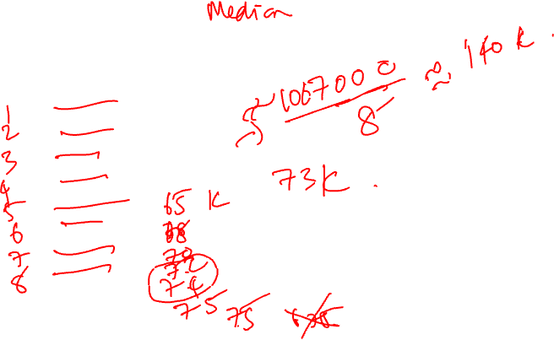
EXERCISE
Mean
Median

Slide 36
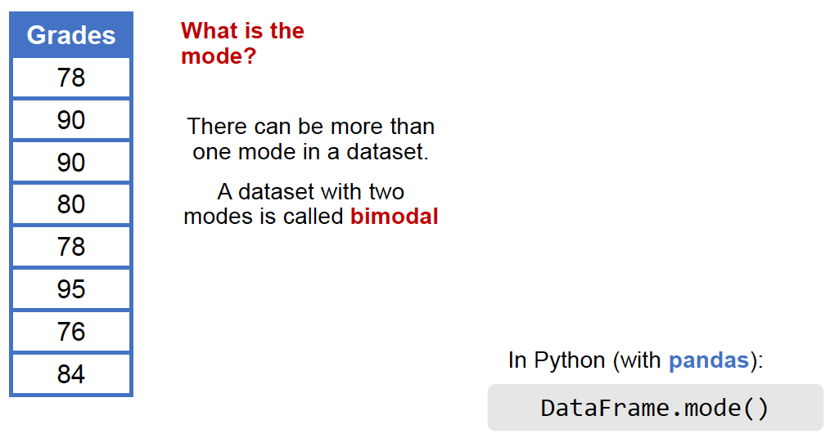
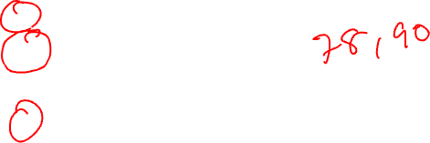
MEASURES OF CENTER: MODE
The mode of a dataset is the most frequent value in the dataset
Example

Slide 37
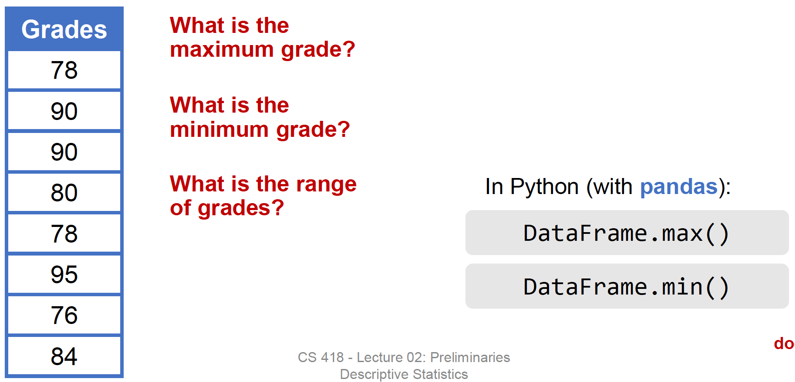
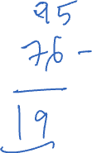
MEASURES OF SPREAD: MAXIMUM, MINIMUM AND RANGE
The maximum of a dataset is the largest value in the dataset
The minimum of a dataset is the smallest value in the dataset
•The range of a dataset is the difference between the maximum and minimum of the dataset
Example

Slide 38
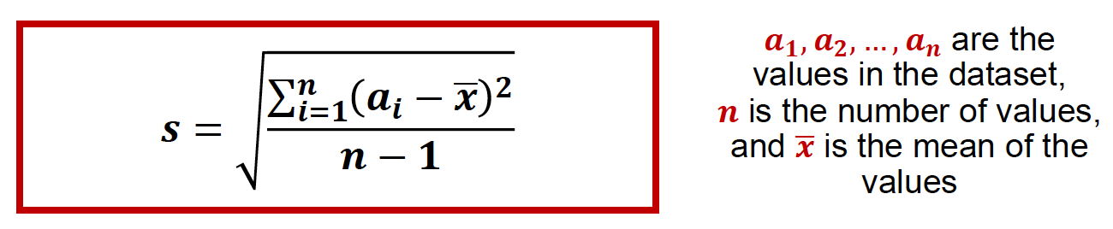
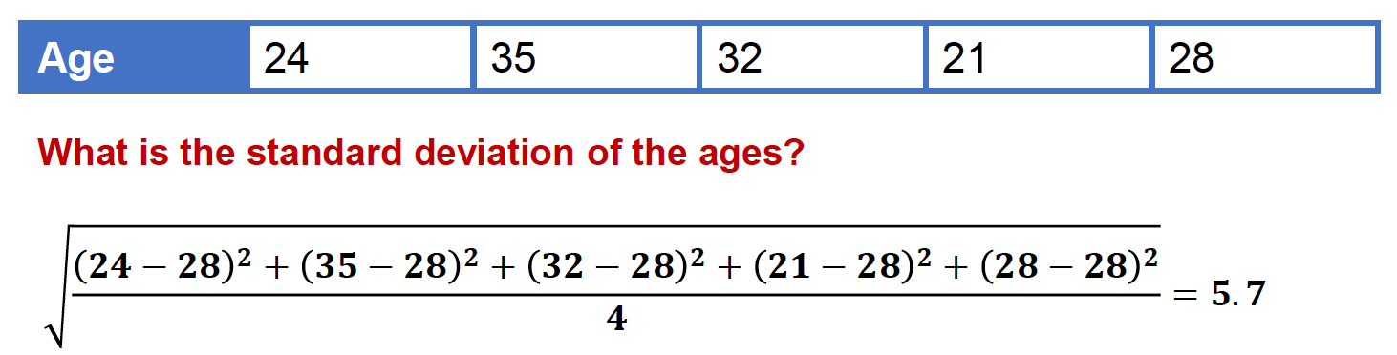
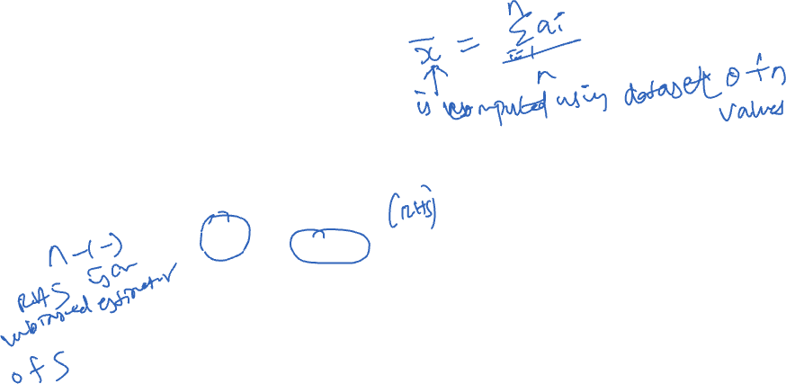
MEASURES OF SPREAD: STANDARD DEVIATION
The standard deviation of a dataset is a measure of the distance between the values in the dataset and the mean of the values
Example

Slide 39
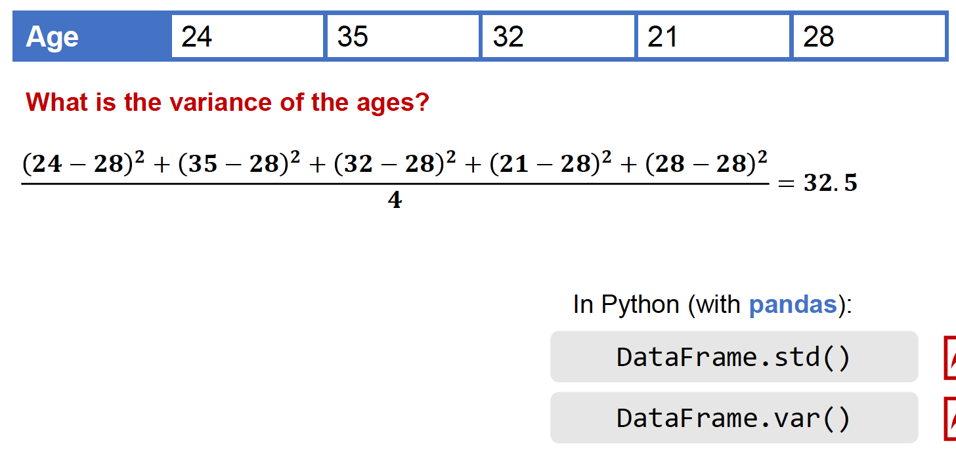
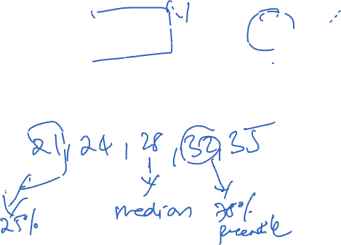
MEASURES OF SPREAD: VARIANCE
The variance of a dataset is the square of the standard deviation
Example

Slide 40
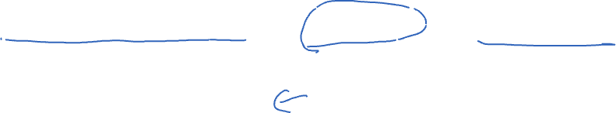
MEASURES OF SPREAD: PERCENTILES AND QUARTILES
Percentiles divide a dataset into 100 equal parts such that % of the data is less than or equal to the 𝒏th percentile
Quartiles divide a dataset into quarters
25% of the data is less than or equal to the first quartile (𝑄1) or 25th percentile
50% of the data is less than or equal to the second quartile (𝑄2) or 50th percentile
𝑄2 is also the median of the dataset
75% of the data is less than or equal to the third quartile (𝑄3) or 75th percentile
The minimum and maximum values, 𝑸𝟏,the median, and 𝑸𝟑 form a set of descriptive statistics called the five-number summary

Slide 41
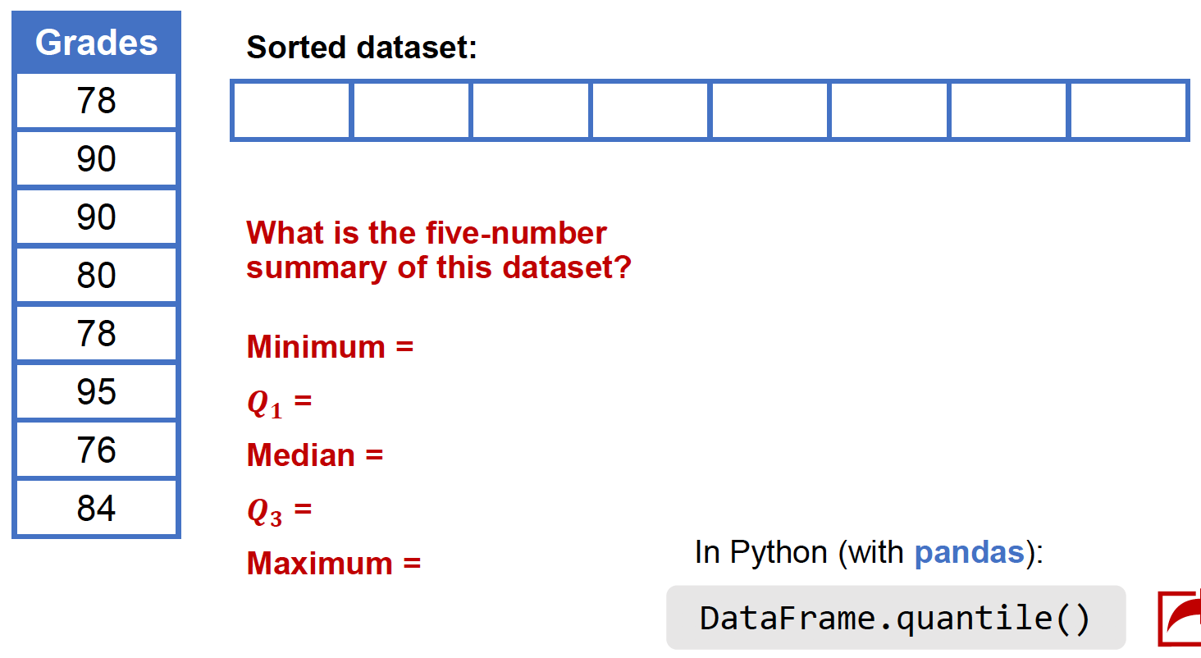
MEASURES OF SPREAD: PERCENTILES AND QUARTILES
Percentiles divide a dataset into 100 equal parts such that % of the data is less than or equal to the 𝒏th percentile
Example

Slide 42
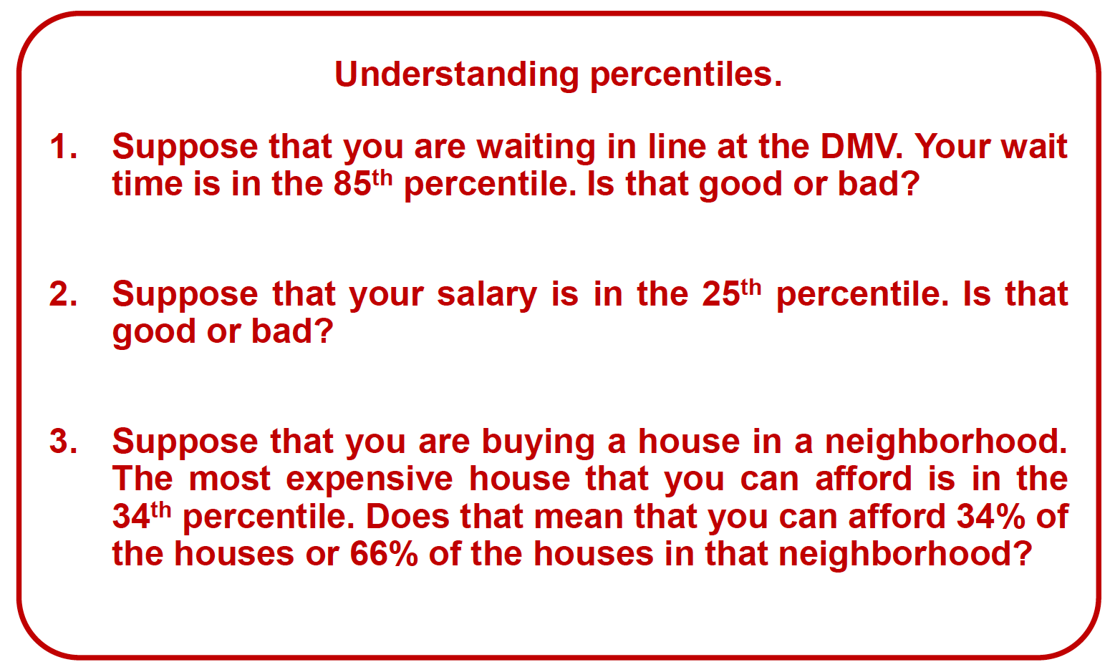
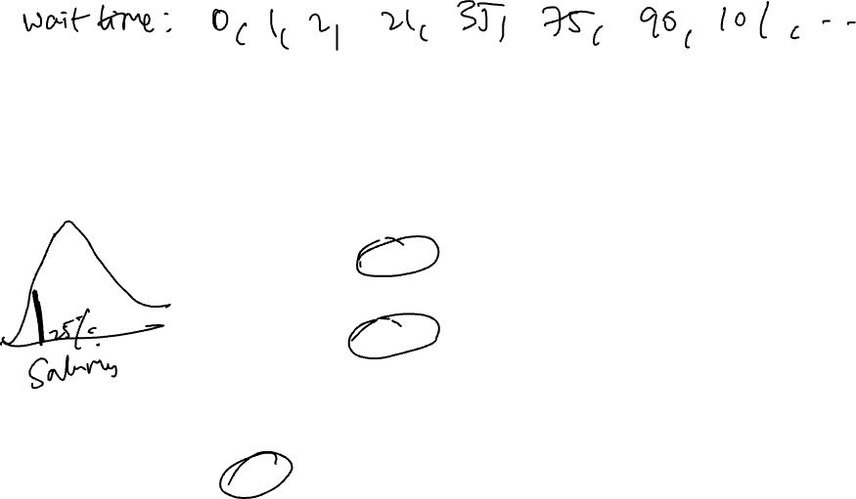
EXERCISE
Reminder: Percentiles divide a dataset into 100 equal parts such that % of the data is less than or equal to the 𝒏th percentile
Good. B. Bad.
Good. B. Bad.
34%. B. 66%

Slide 43
VISUALIZATION AND EDA

Slide 44
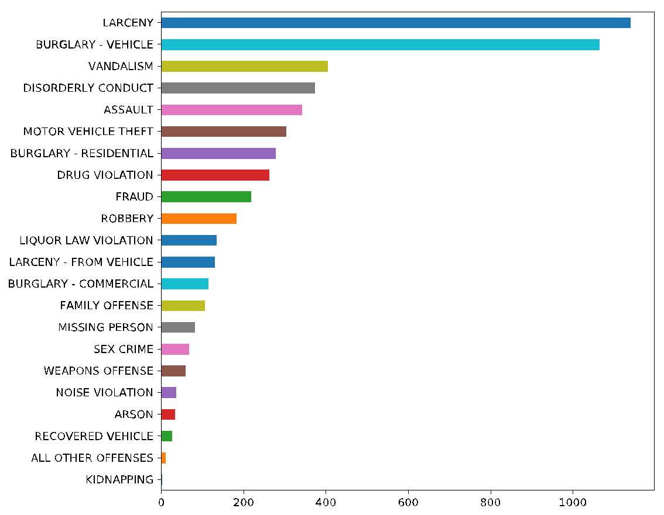
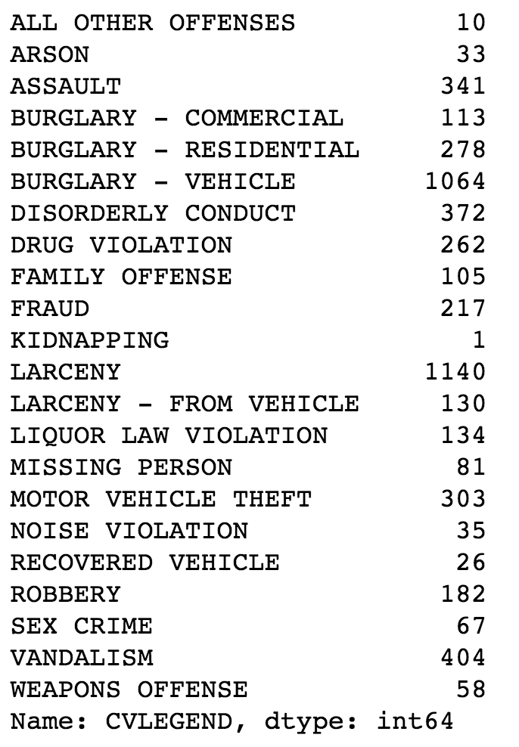
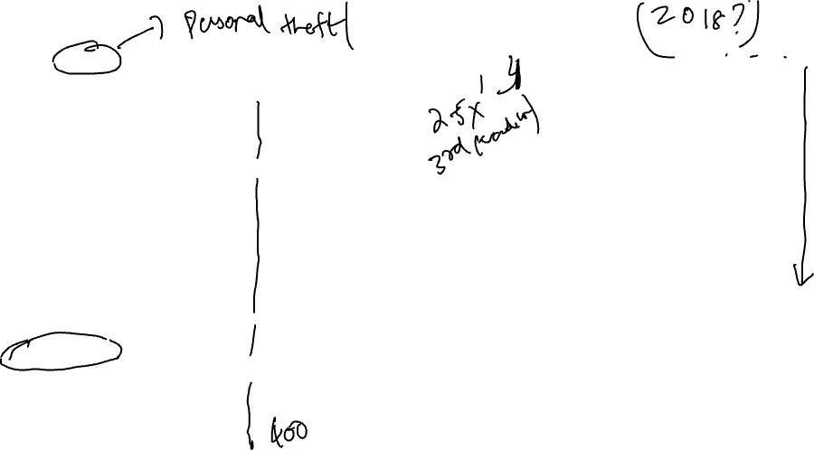
Berkeley Crime Data
Which helps identify key patterns in the data?
Notes:
Larceny=theft of personal property

Slide 45
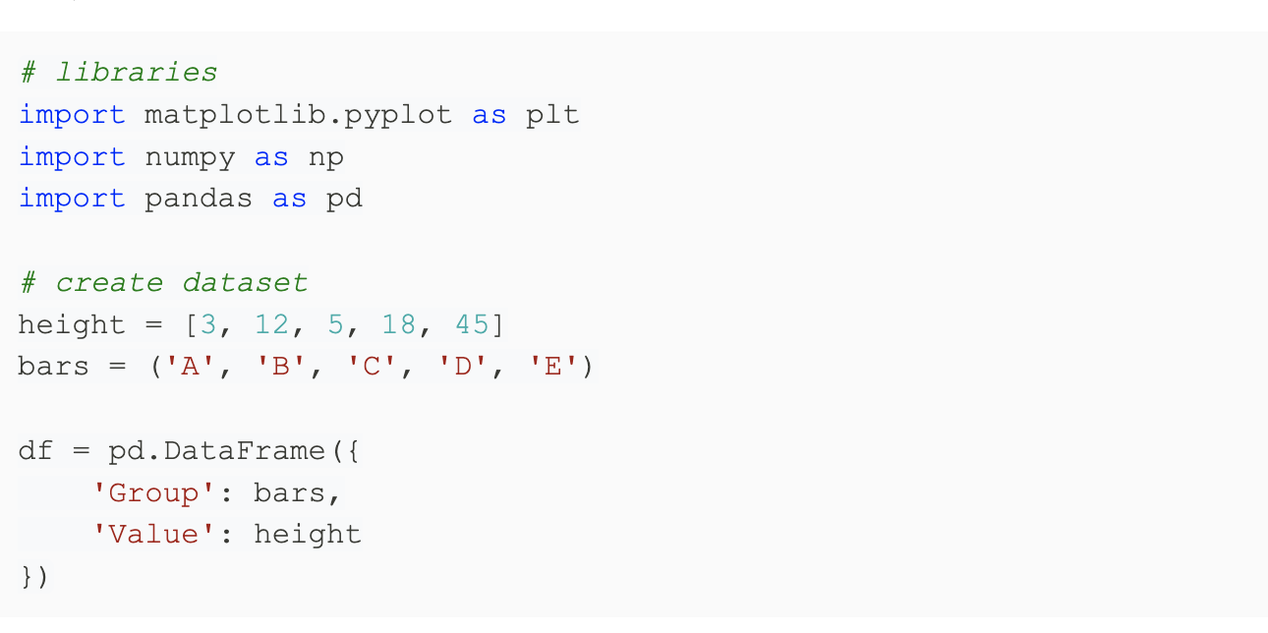
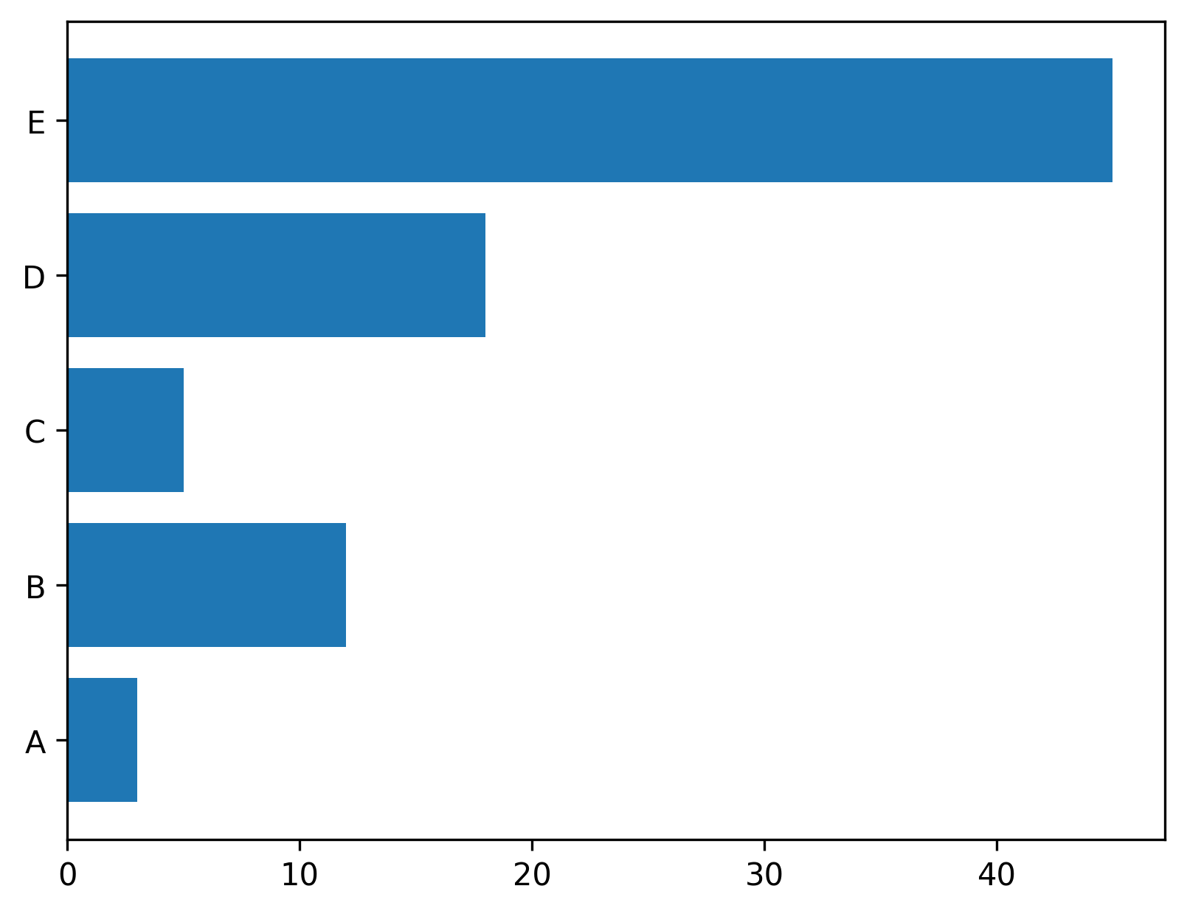
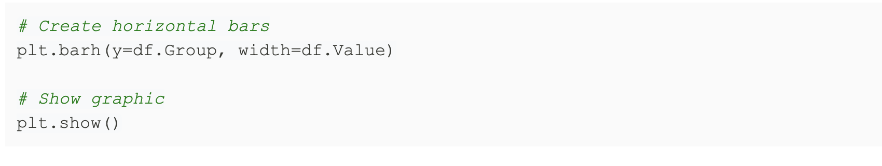
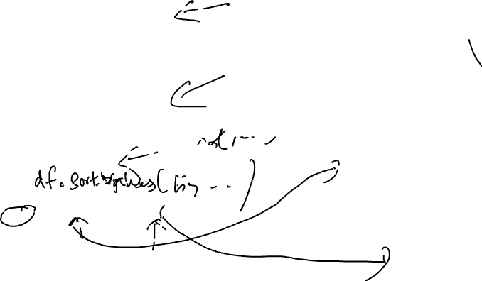
Basic Implementation in Python

Slide 46
TWO TYPES OF VISUALIZATION
Data exploration visualization: figuring out what is true
Data presentation visualization: convincing other people it is true (usually they are related)
This lecture will mostly be focused on the first
“Data exploration” (or EDA) is much broader than just visualization

Slide 47
IMPORTANCE OF VISUALIZATION
Before you run any analysis, build any machine learning system, etc., always understand your data
If you can’t identify a trend or make a prediction for your dataset, neither will an automated algorithm (without huge amounts of data)
This is especially important to keep in mind as you hear stories of “superhuman” performance of AI methods (it is possible, but takes a lot of time/data, and is not the norm)
Visualization can also give you ideas how to represent/clean your data better
For the performance of ML algorithms, the right pre-processing and cleaning can be more important than which specific algorithm you choose

Slide 48
ACKNOWLEDGMENTS
These slides use materials by Berkeley’s DS 100 team, Isabel Cruz, Jiawei Han, Micheline Kamber, Jian Pei, and Elena Zheleva

